Slide 1

Reinforcement Learning

Slide 2
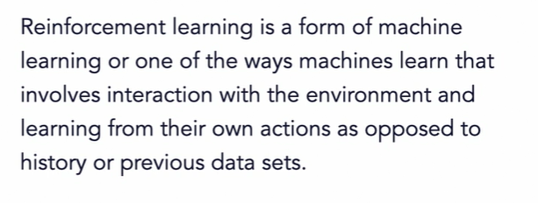
Reinforcement learning

Slide 3
RL
In Reinforcement Learning, the agent learns automatically using feedbacks without any labeled data, unlike supervised learning.
Since there is no labeled data, so the agent is bound to learn by its experience only.
RL solves a specific type of problem where decision making is sequential, and the goal is long-term, such as game-playing, robotics, etc.
The agent interacts with the environment and explores it by itself. The primary goal of an agent in reinforcement learning is to improve the performance by getting the maximum positive rewards.

Slide 4
Terms
Agent (the learner): Agents observe and explore the environment to learn
Environment : Agent’s Learning area
Action: Agent’s choice of activity in a state
Reward: prize for taking a right or wrong action

Slide 5
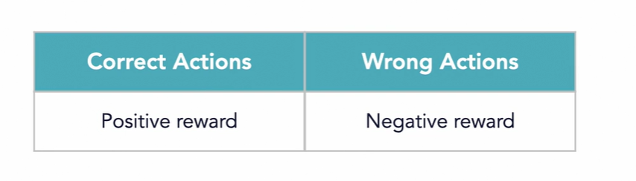
Reward

Slide 6
POLICY
Strategy for deciding the best action

Slide 7
Goal
Agent’s mission

Slide 8
Summary
Agent(): An entity that can perceive/explore the environment and act upon it.
Environment(): A situation in which an agent is present or surrounded by. In RL, we assume the stochastic environment, which means it is random in nature.
Action(): Actions are the moves taken by an agent within the environment.
State(): State is a situation returned by the environment after each action taken by the agent.
Reward(): A feedback returned to the agent from the environment to evaluate the action of the agent.
Policy(): Policy is a strategy applied by the agent for the next action based on the current state.
Value(): It is expected long-term retuned with the discount factor and opposite to the short-term reward.
Q-value(): It is mostly similar to the value, but it takes one additional parameter as a current action (a).

Slide 9
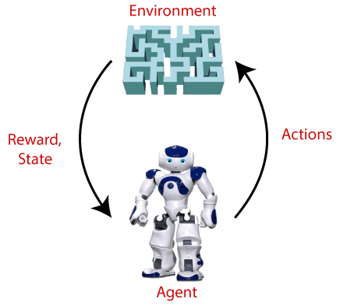
EXAMPLE
Suppose there is an AI agent present within a maze environment, and his goal is to find the diamond.
The agent interacts with the environment by performing some actions, and based on those actions, the state of the agent gets changed, and it also receives a reward or penalty as feedback.
The agent continues doing these three things (take action, change state/remain in the same state, and get feedback), and by doing these actions, he learns and explores the environment.

Slide 10
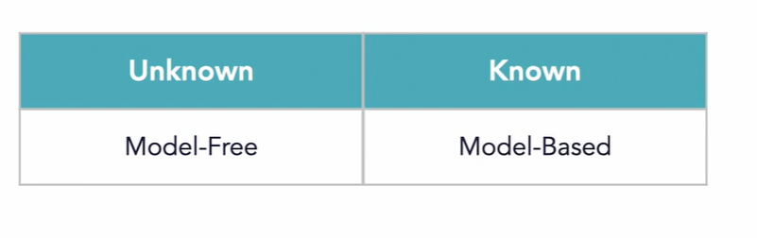
Environment model

Slide 11
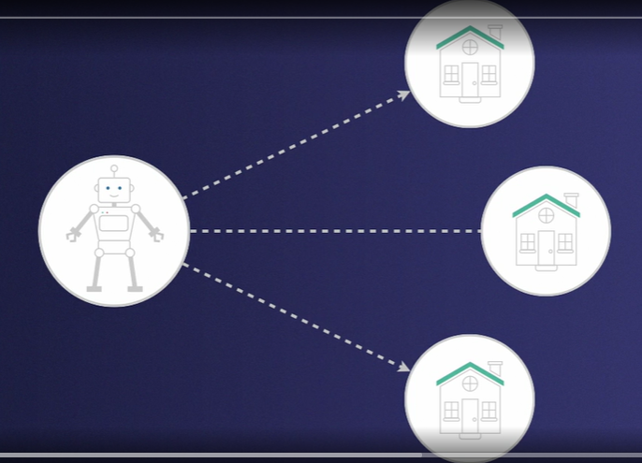
Model free
Searching an apartment

Slide 12
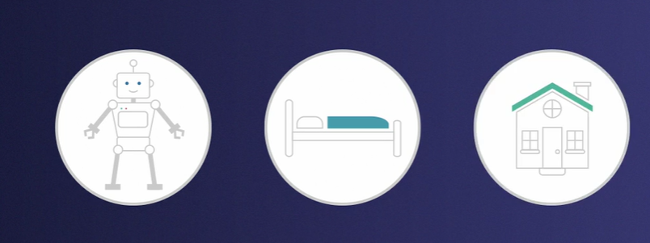
MODEL BASED

Slide 13
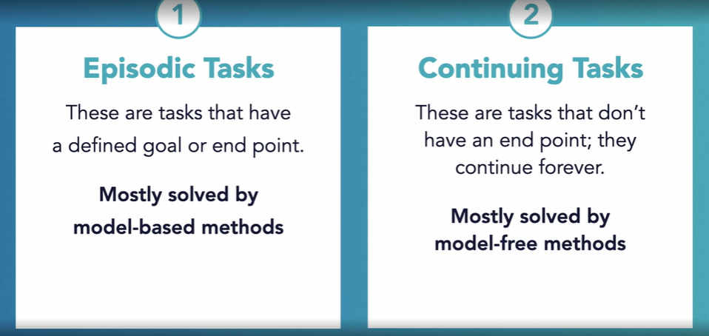
Types of tasks

Slide 14
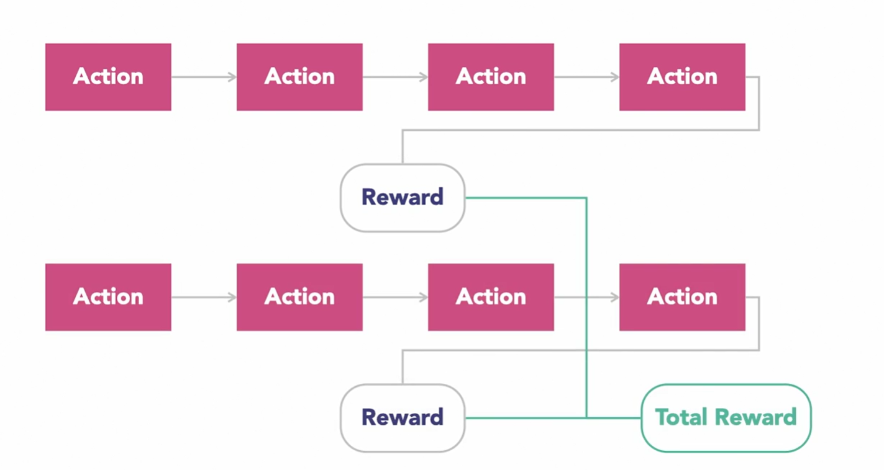

Slide 15
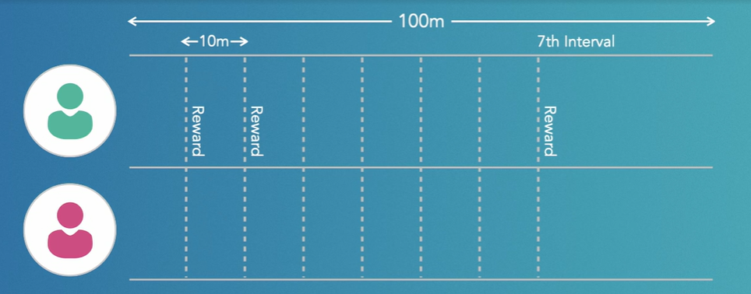
EPISODIC EXAMPLE

Slide 16
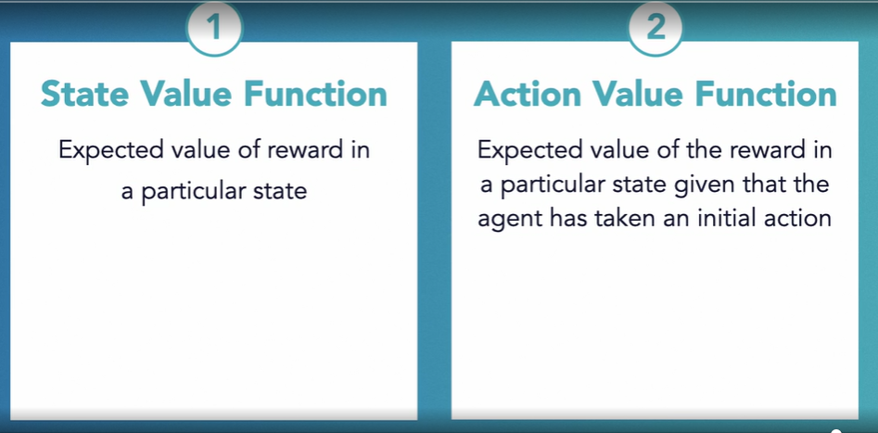
Rl sOLUTION

Slide 17
Approaches to implement Reinforcement Learning
VALUE BASED: Value-based RL attempts to maximize an arbitrary value function, V(s).
MODEL BASED:Model-based RL is based on creating a virtual model for a certain environment and the agent learns to perform within the constraints of the environment.
POLICY BASED (Deterministic and Stochastic): Policy-based RL involves coming up with a policy or deterministic/stochastic strategy to maximize the cumulative reward.

Slide 18
RL ALGORITHMS
Monte Carlo method
Temporal Difference method

Slide 19
Monte carlo method
The Monte Carlo method is used mostly in episodic tasks, tasks that have a definite end.
This method is one way an agents can get the best policy, path or trajectory, so as to get the best cumulative reward. Recall the room full of fruits, but now we'll simplify to have just one fruit, an orange.
There is an equal chance of selecting any of the states, and my actions are also chosen at random. This means I am initially going to follow an equiprobable random policy.

Slide 20
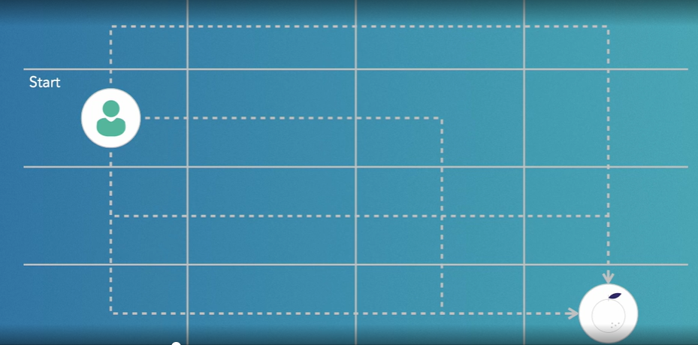
EXAMPLE

Slide 21
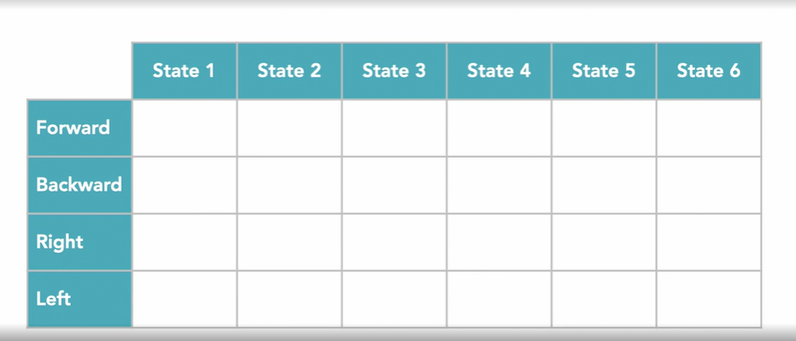
Q-Table

Slide 22
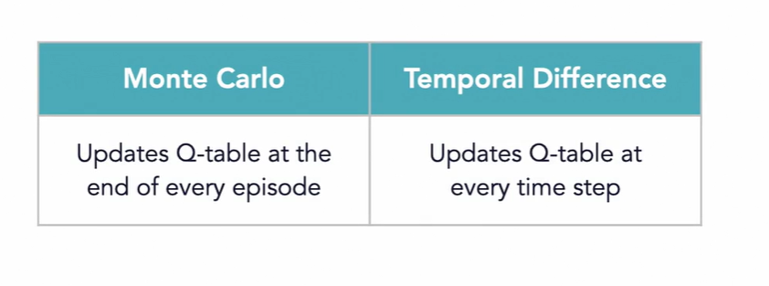
TEMPORAL DIFFERNCE METHOD

Slide 23
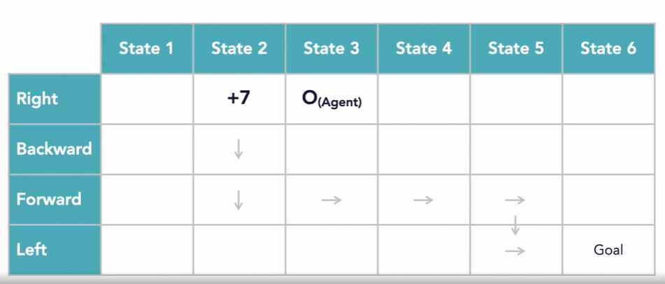
Monte carlo (in detail)

Slide 24
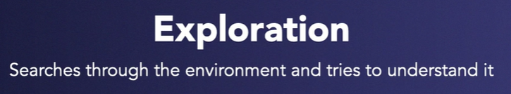

Exploration and exploitation

Slide 25
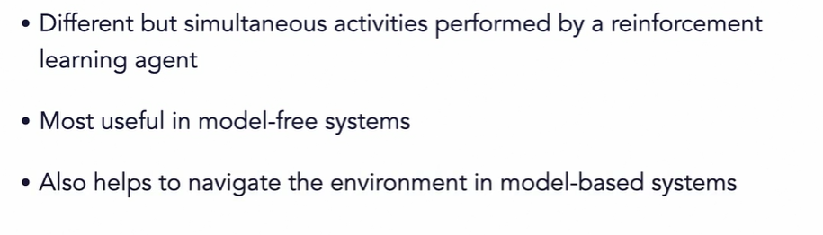

Slide 26
Two ways
Every visit MC: returns for every time s is visited in an episode
First-visit MC: average returns only for first time s is visited in an episode

Slide 27
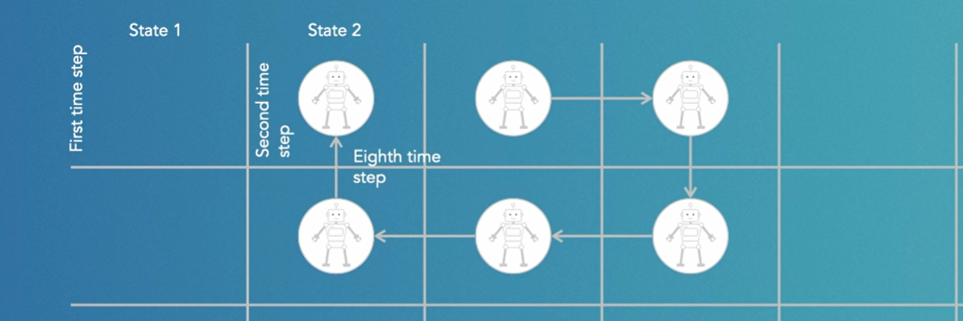

Slide 28
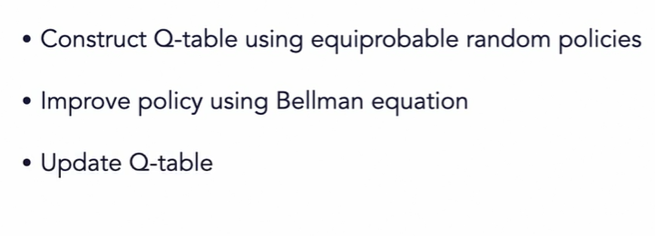
Monte CARLO PROCESS

Slide 29
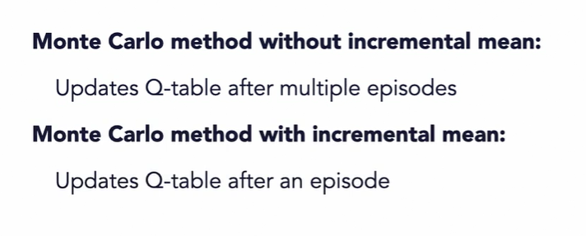
POLICIES
Greedy Policies: Policies that only select the best option
Epsilon Greedy Policies: Policies that select other options
Incremental Mean: Used to update the policy after every episode

Slide 30
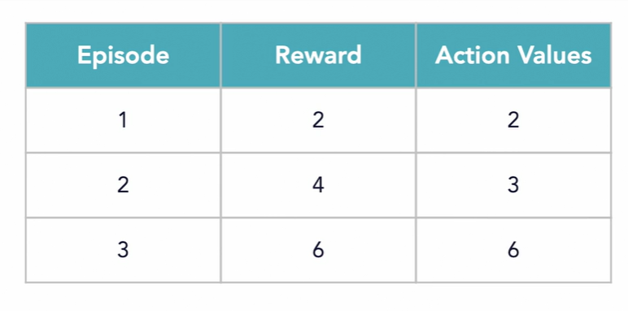

Slide 31
Modified forms of RL
Deep RL
Multi-agent RL
Inverse RL

Slide 32
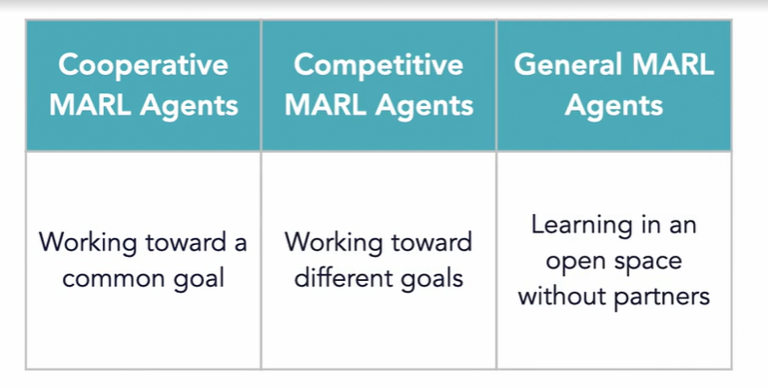
Multi-agent rl

Slide 33
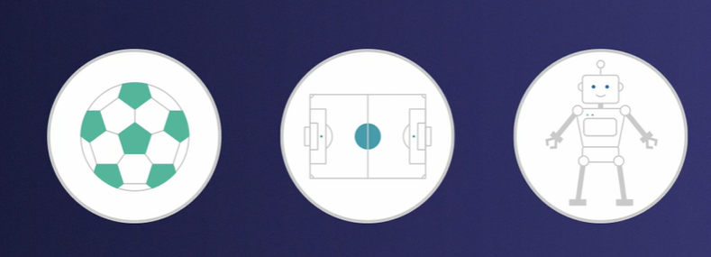
EXAMPLE

Slide 34
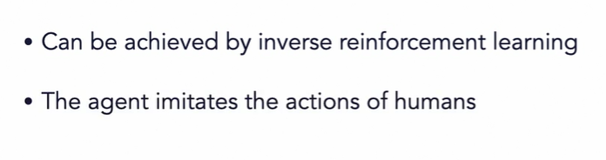
INVERSE RL

Slide 35
Readings
http://www.javatpoint.com/reinforcement-learning

